Slide 1
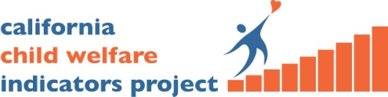



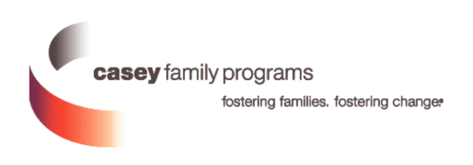
Nebraska
Children’s Commission
Retreat
10/19/2017
Partnering for Change
Collaborating with Child Welfare Jurisdictions
for Ongoing System Improvement
Daniel Webster, PhD
Center for Social Services Research
University of California, Berkeley
CCWIP is a collaboration of the University of California and the California Department of Social Services
and is supported by CDSS, the Stuart Foundation, and the Conrad N. Hilton Foundation

Slide 2
OUTLINE
CCWIP Background
Supporting data-driven work
  Key concepts & tools
  Approaches that have worked
  Challenges encountered
Website Demonstration
The unfolding child welfare data landscape

Slide 3

Understanding Child Welfare Dynamics
B.C.E
(Before the CCWIP Era)
California CW System
a bunch of stuff happens
CHILD IN
CHILD OUT
*adapted from Lyle, G. L., & Barker, M.A. (1998). Patterns & Spells: New approaches to conceptualizing
children’s out of home placement experiences. Chicago: American Evaluation Association Annual Conference
Notes:
3

Slide 4
CCWIP
Positive Impact on the Field of Child Welfare
Model for Public-University Collaboration
History of Informing Social Policy
Tool for System Reform
Resource for Stakeholders
Leader in Innovation
Notes:
Collaboration
California Department of Social Services
Children’s Data Network, USC
AOC
Children’s Research Center
Statewide Data Committee
Stuart Foundation
Other states considering public sites FL,
Social Policy—asfa, kingap,
System reform—ab636
Trusted resource—to policy makers, legislators, trainers, CW administrators, program evaluators,
for reliable public data, TA, education of professionals, emerging topics [disproportionality]

Slide 5
Data Driven Decision Making:
Successful Approaches
Building blocks for working with data:
  Key concepts to create a common language
  Tools to assist in targeting efforts
  Creating a shared narrative
Equipping Staff to Practice CQI:
  Data kick-off orientation with leadership
  Data 101 trainings for workers at all levels
  Follow up TA, webinars, etc. on specific topic

Slide 6
Key Concepts:
Different Views of Longitudinal Data
January 1, 2016
January 1, 2017
January 1, 2018
Child 1
Child 2
Child 3
Child 4
Child 5
Child 6
Child 7
Child 8
Child 9
Child 10

Slide 7
Key Concepts:
Understanding Follow-up Time
2015
2016
2017
2018
ENTRY COHORT
ENTRY COHORT
April 1, 2016-March 31, 2017
Oct. 1, 2012 – Sept. 30, 2016
Jan. 1, 2016 – Dec. 31, 2016
Jan. 1
Dec. 31
Jan. 1
Dec. 31
Jan. 1
Dec. 31
Jan. 1
Dec. 31
Last day of data prior to cut-off
Sept. 30, 2017
Last day of data prior to cut-off
Dec. 31, 2017
Last day of data prior to cut-off
March 31, 2018

Slide 8
Key Concepts:
Inter-related Outcomes
Rate of Referrals/
Substantiated Referrals
Home-Based
Services vs.
Out-of-Home
Care
Reentry to Care
Permanency
Through
Reunification,
Adoption, or
Guardianship
Counterbalanced
Indicators of
System
Performance
Use of Least
Restrictive
Form of Care
Shorter
Lengths
Of Stay
Maintain Positive Attachments
To Family,
Friends, and
Neighbors
Stability
Of Care
Notes:
Source: Usher, C.L., Wildfire, J.B., Gogan, H.C. & Brown, E.L. (2002). Measuring Outcomes in Child Welfare. Chapel Hill: Jordan Institute for Families

Slide 9
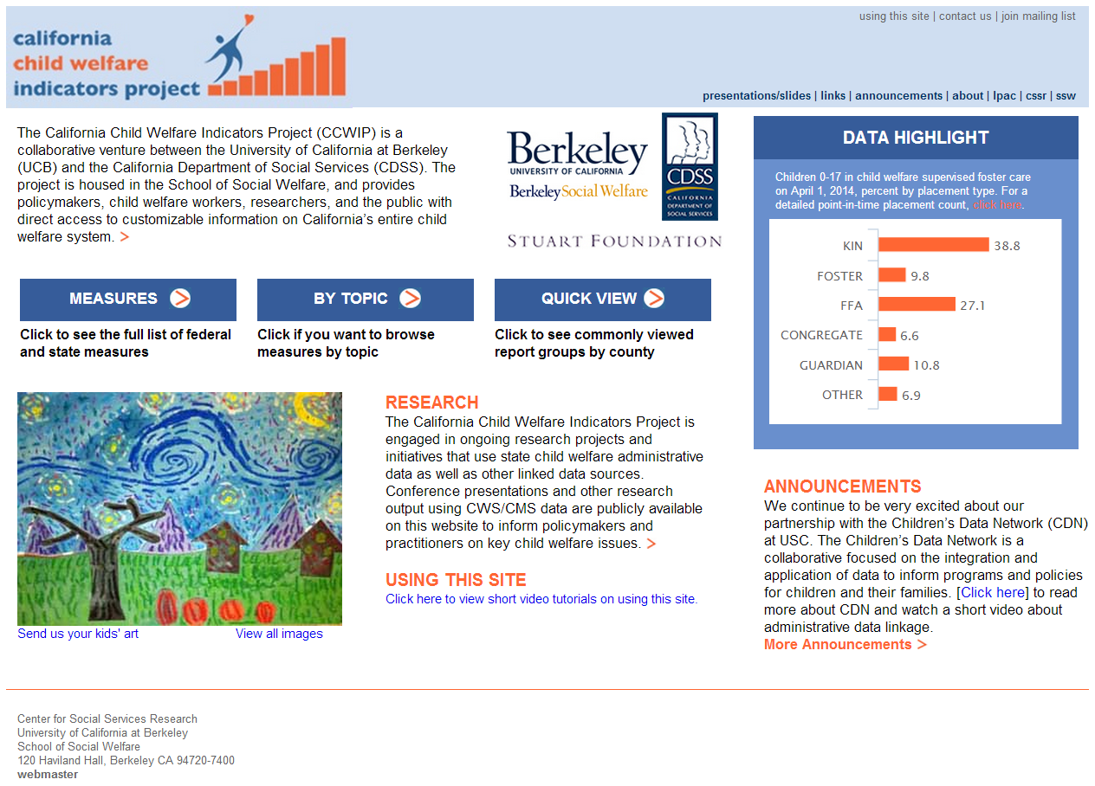
Tools for the Feedback Loop:
Public Data Portal for Accountability and Transparency

Slide 10
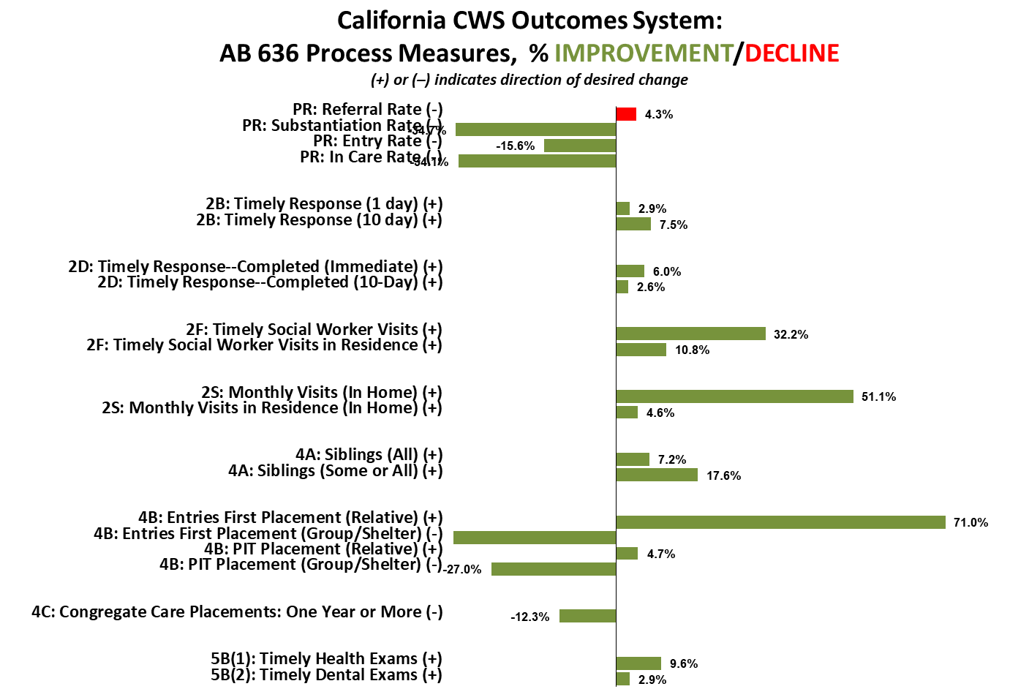
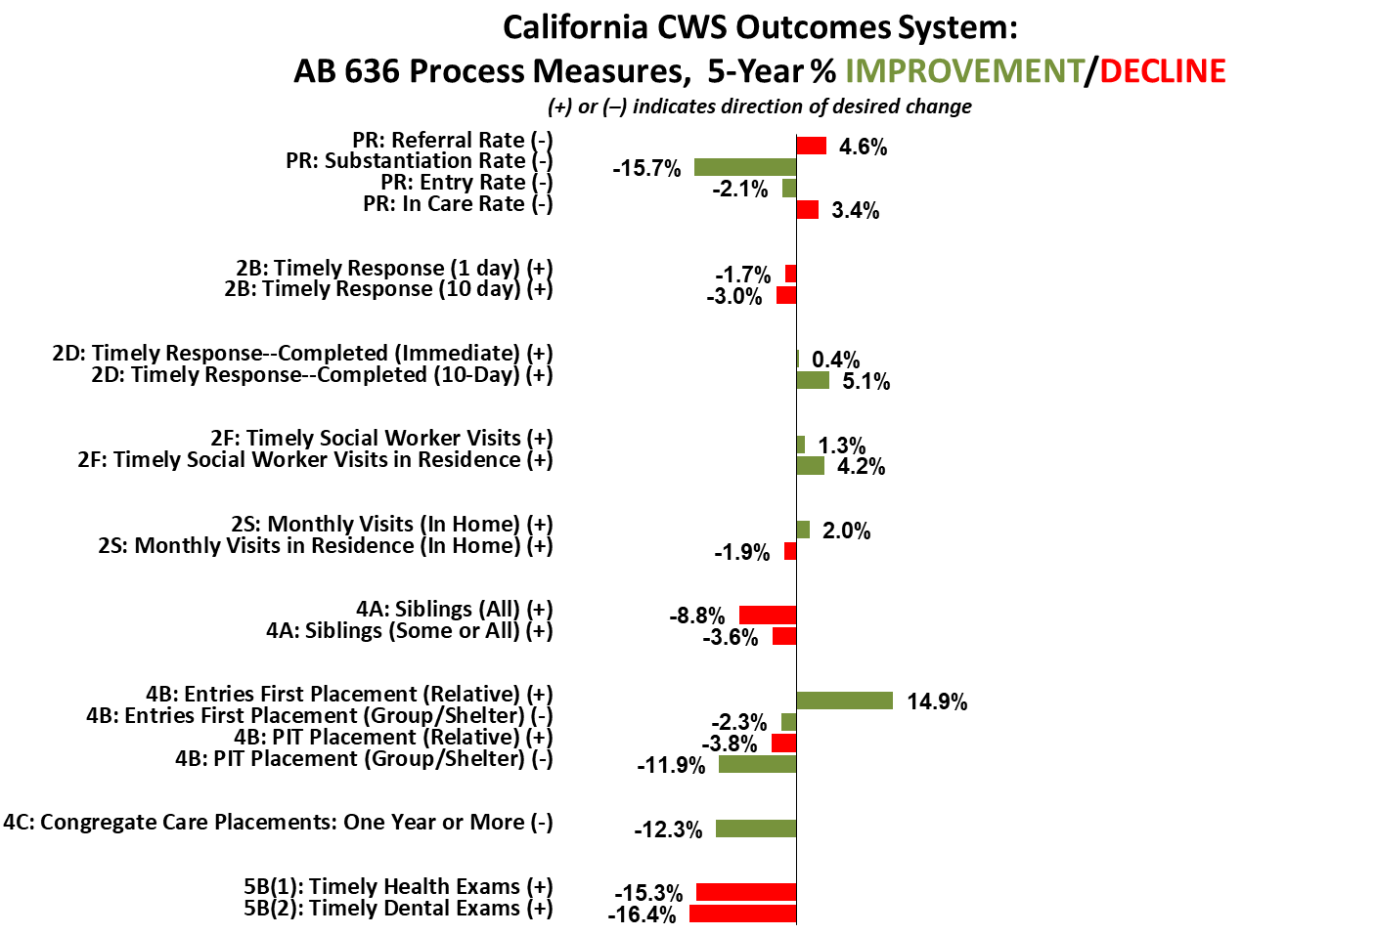
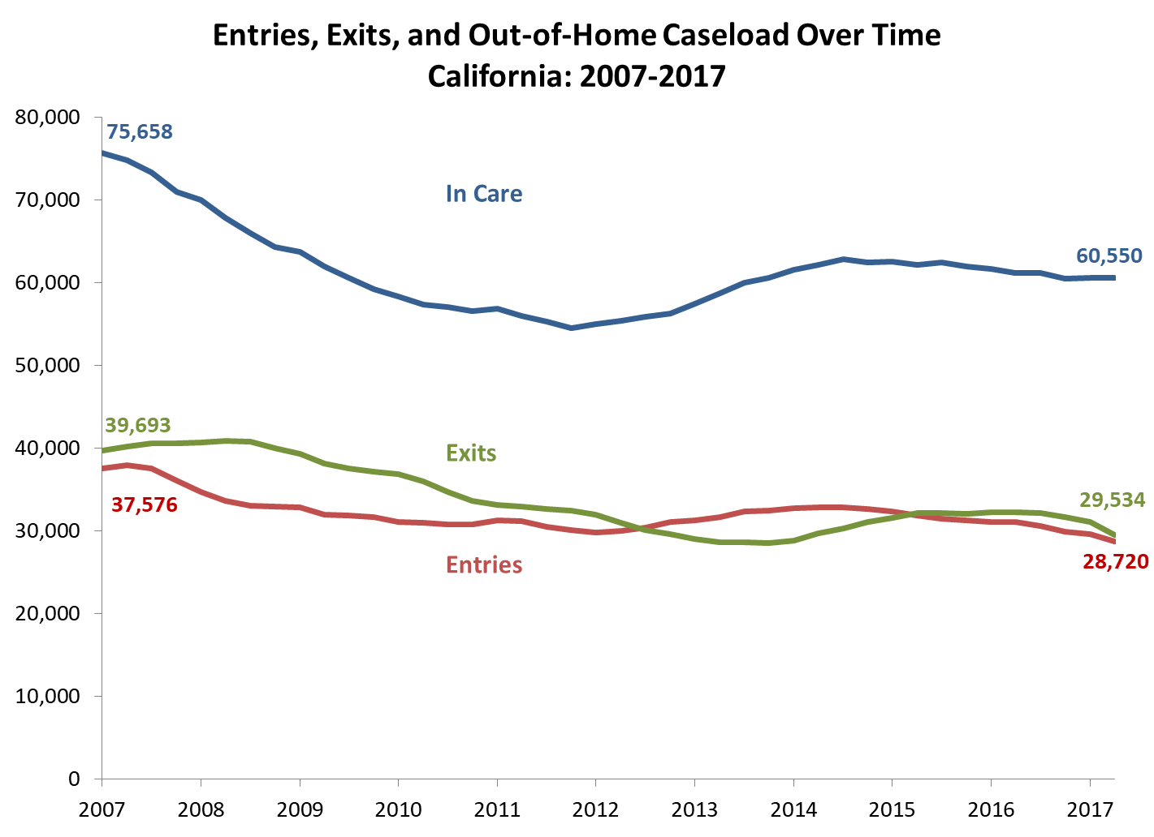
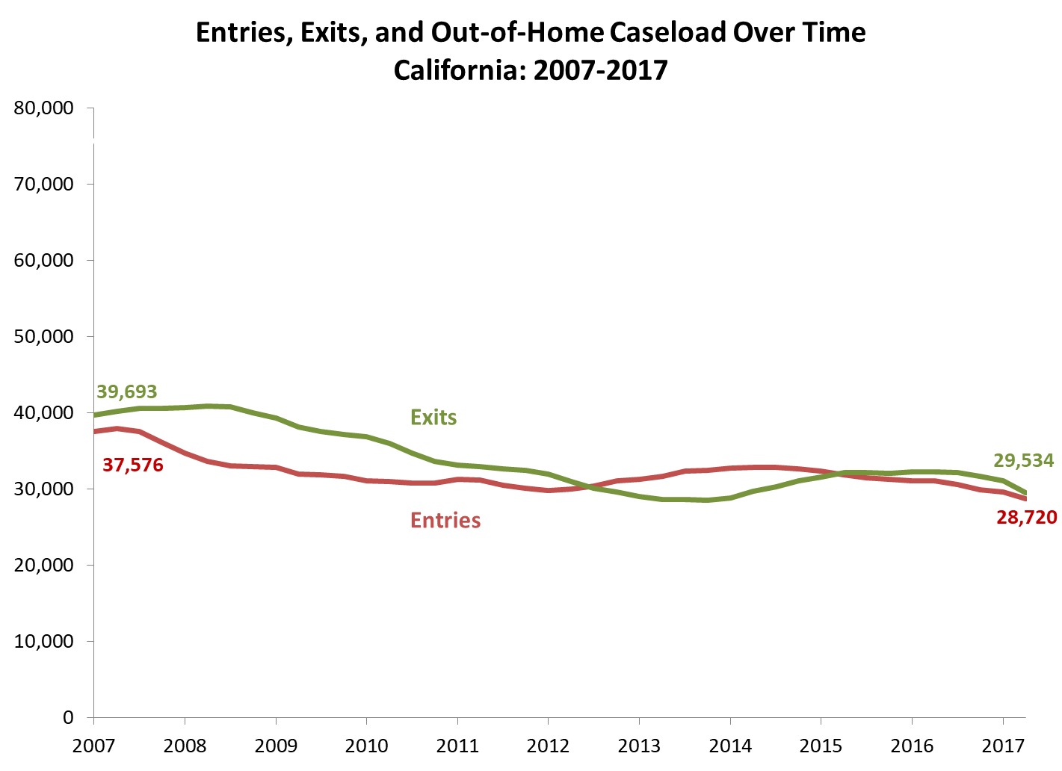
Tools for the Feedback Loop:
Monitoring Program Improvement & System Reform

Slide 11
Tools for the Feedback Loop:
Monitoring Program Improvement & System Reform

Slide 12
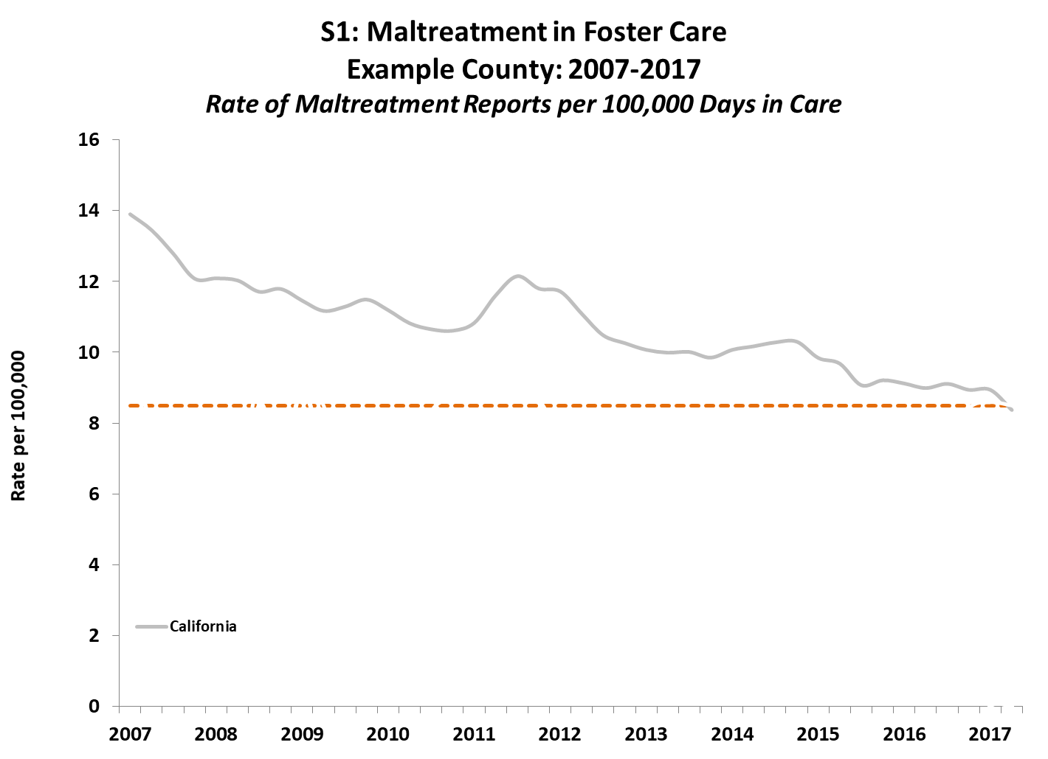
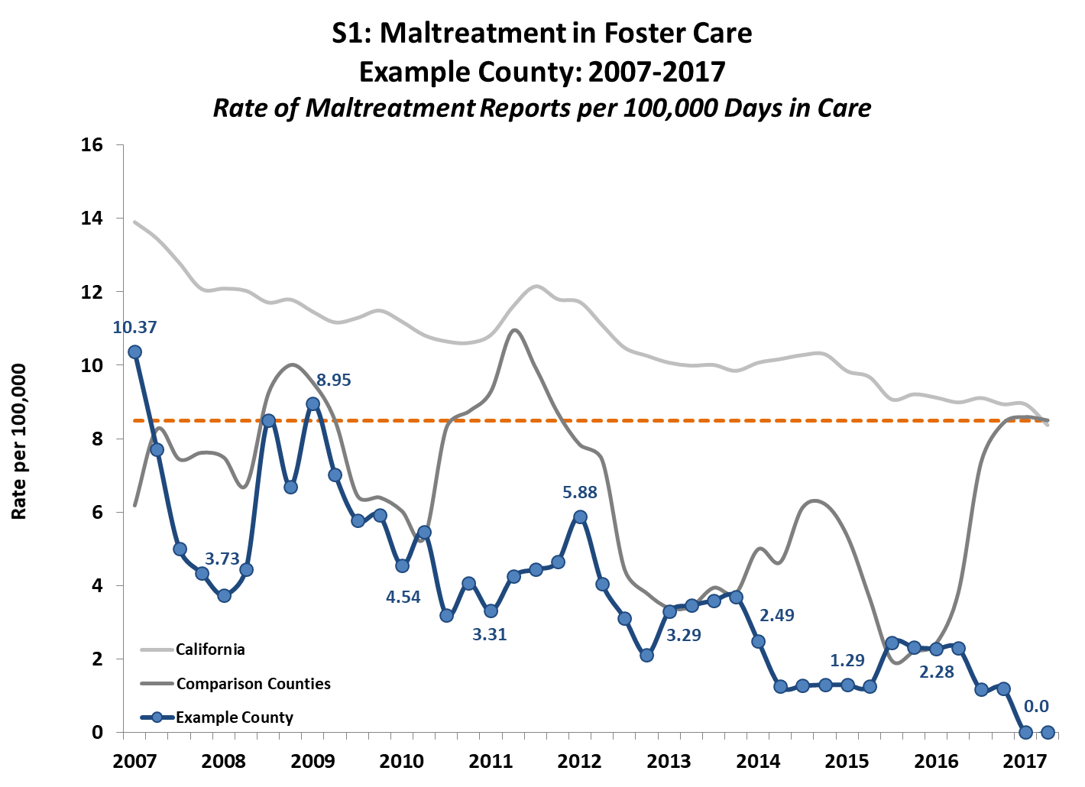
Creating a Shared Narrative
to target efforts and promote system reform
Notes:
As Fred W. has stated, cw system narratives are about changes occurring over time, and we need to understand what accounts observed differences over time [attributes of the case mix, geographies, etc.]

Slide 13
Data Driven Decision Making:
Successful Approaches
Building blocks for working with data:
  Key concepts to create a common language
  Tools to assist in targeting efforts
  Creating a shared narrative
Equipping Staff to Practice CQI:
  Data kick-off orientation with leadership
  Data 101 trainings for workers at all levels
  Follow up TA, webinars, etc. on specific topic

Slide 14
Data Driven Decision Making:
Challenges Encountered
  Data Abuse !
  Leadership and Staff Changes
  Moving to a Deeper Level of Analysis
  Coordination Amongst Multiple Organizations

Slide 15
Perils of Data Abuse
There are three kinds of lies:
Lies, Damned Lies and Statistics
^
Abused Statistics
Notes:
“There are three kinds of lies: Lies, Damned Lies, and Statistics”.
A very common quote (often credited to Mark Twain, although actually coined by Benjamin Disraeli)
But perhaps this should be amended, as it is not that statistics lie, rather it is that statistics can be misused to misrepresent the underlying data, overstate the conclusions that can be drawn, and bolster an inaccurate argument.

Slide 16
Public Data:
Putting it all Out There
PROS:
  greater performance accountability
  community awareness and involvement, encourages public-private partnerships
  ability to track improvement over time, identify areas where programmatic adjustments are needed
  Region/region and region/county collaboration
  transparency
CONS:
  Potential for misuse, misinterpretation, and misrepresentation
  Available to those with agendas or looking to create a sensational headline
  Misunderstood data can lead to the wrong policy decisions
  “Torture numbers, and they’ll confess to anything”
  (Gregg Easterbrook)

Slide 17
Six Ways to Abuse Data
(Without Actually Lying)
Compare Apples and Oranges
Use ‘snapshots’ of Small Samples
Rely on Unrepresentative Findings
Logically ‘flip’ Statistics
Falsely Assume an Association to be Causal
Rely on Summary Statistics

Slide 18
Data Snapshots…
Crime in a city …
Number of Crimes
Period 1: 76
Period 2: 51
Period 3: 91
Period 4: 76
No change.
Average = 73.5
Crime jumped by 49%!!
Crime dropped by 16%

Slide 19
Response to Data Abuse?
Must have the will to weather the storm(s)…
Continued efforts to frame the data, educate interested media, policymakers, and others
  what do these findings mean?
  how can these data be used to gain insight into where improvements are needed?
Agencies must be proactive in discussing both the “good” and the “bad” (be first, but be right).
  be transparent
  if not playing offense…playing defense

Slide 20
Data Driven Decision Making:
Challenges Encountered
  Data Abuse !
  Leadership and Staff Changes
  Moving to a Deeper Level of Analysis
  Coordination Amongst Multiple Organizations

Slide 21
Collaborating stakeholders
Partnering Agencies
  California Department of Social Services
  Center for Social Services Research, UC Berkeley
  Philanthropic Organizations (Stuart, Casey, Hilton)
  Children’s Research Center
  Statewide and County Committees
CDSS & UC Berkeley share responsibility for child welfare reporting, analysis, and official publications
  http://cssr.berkeley.edu/ucb_childwelfare/
  http://www.dss.cahwnet.gov/research/default.htm
State and UC Berkeley data reports
  Public
  Aggregated data, providing drill down to county level
  Dynamic stratification

Slide 22
A Public Data Portal:
Promoting Accountability & Transparency
http://cssr.berkeley.edu/ucb_childwelfare/

Slide 23
Brief Website Demo
Measures Basic Organization--AB 636 measures, etc.
Quick View & LPAC Resources
Dynamic Report Features
  Clustering, Filters
  Multi-reports
  Graphing
Other Resources
  Case Openings, Closings, Point-in-Time Reports
  Median Length of Stay
  Poverty Data & Disparity Indices
Outcomes Spreadsheet & Key Outcomes Tool

Slide 24
Moving Forward
New Challenges and Opportunities
Support the field
  Data Visualization & Mobile Friendly Interfaces
  Assist sites in developing site-specific outcome metrics
Turn Data into Knowledge
  Develop Modalities to Educate current and emerging professionals
  Promote familiarity of data throughout agencies
  Support the link from outcome to practice (CRR, Multivariate)
Partner for Broader Impact
  Data Linkages
  Cross-System Outcome Reporting
  Predictive Analytics

Slide 25


Questions? dwebster@berkeley.edu
510.290.6779

